Slide 1
Know Your Rights:
Demonstrations & Police Encounters
Prepared by Eric M. Fink
Elon Law School
Greensboro, North Carolina

Slide 2
Legal Matters
This is a general overview of issues that may arise in political demonstrations and police encounters. The information presented is not offered or intended as legal advice.
This work is licensed under the Creative Commons Attribution-NonCommercial-ShareAlike 4.0 International License.
To view a copy of this license, visit http://creativecommons.org/licenses/by-nc-sa/4.0/.

Slide 3
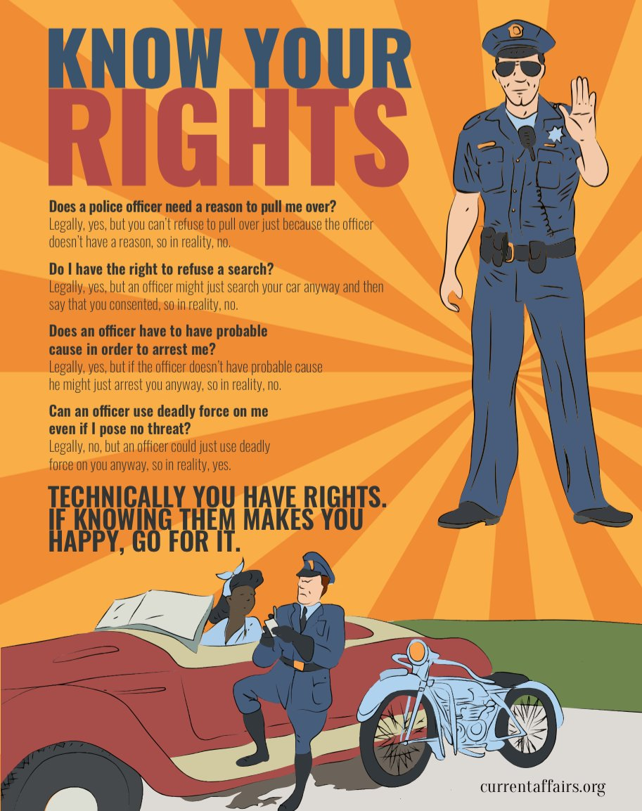

Slide 4
Demonstrations:
1st Amendment

Slide 5
1st Amendment
Congress shall make no law … abridging the freedom of speech, or of the press; or the right of the people peaceably to assemble, and to petition the Government for a redress of grievances.

Slide 6
1st Amendment
Applies to government restraints on speech & assembly.

Slide 7
1st Amendment
“Speech” includes expressive conduct:
Body Language
Clothing
Flag Burning

Slide 8
1st Amendment
All levels of government:
Federal
State
Local

Slide 9
1st Amendment
All government branches & agencies:
Legislative: US Congress, NC General Assembly, County Commission, City Council
Executive: President, Governor, Mayor
Judicial: Courts
Law Enforcement: Police, Prisons

Slide 10
1st Amendment
Unlawful restraint:
Government may not forbid, restrain, limit, or punish protected 1st Amendment activity based on
Content, subject, or viewpoint
Political affiliation, or association

Slide 11
1st Amendment
Applies to prior restraints and to restraints or punishments during or after the protected activity.

Slide 12
1st Amendment
Lawful regulation:
Government may regulate the time, place, & manner of speech/assembly.

Slide 13
1st Amendment
Examples:
Permits for use of certain public places
Noise ordinances & regulations of sound equipment,
Restrictions on posting signs or flyers
Prohibitions against blocking pedestrian or vehicular traffic

Slide 14
1st Amendment
Public Forum:
A place traditionally open to unrestricted public speech & activity. Examples:
Sidewalks
Parks
Plazas outside government buildings

Slide 15
1st Amendment
Protection is greatest, and scope of permissible government regulation narrowest, in traditional public forums. Normally, no permit may be required for 1st Amendment activity in a public forum:
Picketing
Marching
Distributing literature
Soliciting donations

Slide 16
1st Amendment
Even in a traditional public forum, government may regulate or prohibit certain activity that may interfere with access to and use of the space:
May require permits for setting up tables, large signs, etc.
May prohibit blocking entries to buildings
May prohibit blocking others from passing

Slide 17
1st Amendment
Unprotected speech:
Obscenity
But mere profanity is protected
Child Pornography
But pornagraphy that depicts adults is protected if not obscene
Incitement,Fighting Words, True Threats
“imminent lawless action”, “immediate breach of the peace”
Defamation

Slide 18
1st Amendment
Unprotected activity, even if expressive:
Destroying or defacing public or private property (without permission of the property owner)
Use or threat of physical force against others
“True threat” doctrine: context matters

Slide 19
Masks in Public Places
Anti-Mask Laws
N.C.G.S. §14-12.7. Wearing of masks, hoods, etc., on public ways.
No person or persons at least 16 years of age shall, while wearing any mask, hood or device whereby the person, face or voice is disguised so as to conceal the identity of the wearer, enter, be or appear upon any lane, walkway, alley, street, road, highway or other public way in this State. (1953, c. 1193, s. 6; 1983, c. 175, ss. 1, 10; c. 720, s. 4.)
N.C.G.S. §14-12.8. Wearing of masks, hoods, etc., on public property.
No person or persons shall in this State, while wearing any mask, hood or device whereby the person, face or voice is disguised so as to conceal the identity of the wearer, enter, or appear upon or within the public property of any municipality or county of the State, or of the State of North Carolina. (1953, c. 1193, s. 7.)

Slide 20
Masks in Public Places
D.C. Code § 22-3312.03. Wearing hoods or masks. (a) No person or persons over 16 years of age, while wearing any mask, hood, or device whereby any portion of the face is hidden, concealed, or covered as to conceal the identity of the wearer, shall: (1) Enter upon, be, or appear upon any lane, walk, alley, street, road highway, or other public way in the District of Columbia; (2) Enter upon, be, or appear upon or within the public property of the District of Columbia; or (3) Hold any manner of meeting or demonstration. (b) The provisions of subsection (a) of this section apply only if the person was wearing the hood, mask, or other device: (1) With the intent to deprive any person or class of persons of equal protection of the law or of equal privileges and immunities under the law, or for the purpose of preventing or hindering the constituted authorities of the United States or the District of Columbia from giving or securing for all persons within the District of Columbia equal protection of the law; (2) With the intent, by force or threat of force, to injure, intimidate, or interfere with any person because of his or her exercise of any right secured by federal or District of Columbia laws, or to intimidate any person or any class of persons from exercising any right secured by federal or District of Columbia laws; (3) With the intent to intimidate, threaten, abuse, or harass any other person; (4) With the intent to cause another person to fear for his or her personal safety, or, where it is probable that reasonable persons will be put in fear for their personal safety by the defendant's actions, with reckless disregard for that probability; or (5) While engaged in conduct prohibited by civil or criminal law, with the intent of avoiding identification.

Slide 21
Masks in Public Places
The constitutional status of anti-mask laws is uncertain.
Courts have upheld criminal convictions under these laws against challenges based on the 1st Amendment. See, e.g., Church of Am. Knights of the Ku Klux Klan v. Kerik, 356 F.3d 197 (2d Cir. 2004)
But selective enforcement or prosecution based on viewpoint, political association, etc. would violate the 1st Amendment

Slide 22
Photography & Video Recording
A person who is lawfully present in a public place may take photographs or video recordings of anything and any person in plain view

Slide 23
Photography & Video Recording
A police officer or other government actor may not lawfully prohibit you from, or arrest you for, taking photos or video recordings in a public place.

Slide 24
Photography & Video Recording
A police officer or other government actor may not lawfully seize your equipment, demand to view your photos or video, or delete your photos or video without a warrant

Slide 25
Photography & Video Recording
A police officer or other government actor may lawfully order you to cease activity, including photography or video recording, if it is interfering with an arrest or other legitimate law enforcement activity

Slide 26
Photography & Video Recording
You do not need permission to photograph or make video recordings of any person who is in plain view from a public place
Many people do not understand this and may object that taking photos or making video recordings of them without their permission is a violation of their privacy or other legal rights.
It is unlawful for any person to use physical force to stop you from taking photos or video recordings in a public place

Slide 27
Photography & Video Recording
The owner of private property may prohibit or restrict photography and video recording on the property.
But a property owner may not prohibit you from taking photos or video recordings of the property from a public place.

Slide 28
Photography & Video Recording
Several states, including North Carolina, have enacted so-called “Ag-Gag” or “Data Trespass” laws that restrict photographs, videos, and other recording of private property without the owner’s permission.
As applied to photography or recording made from a public place, criminal or civil liability under those laws is likely unconstitutional.

Slide 29
Photography & Video Recording
Audio recordings may be subject to greater restriction.
In some states (including NC, VA, & DC), it is lawful to make an audio recording of a conversation as long as one party to the conversation consents.
This may include the person who is making the recording, if that person is also a party to the conversation.
In other states, all parties to the conversation must consent.

Slide 30
Police Encounters

Slide 31
Police Questioning
In general, a police officer may lawfully ask you questions at any time, without having to demonstrate reasonable suspicion or probable cause.

Slide 32
Police Questioning
The constitutional “right to remain silent” means that you are not required to answer questions from a police officer or other government agent.
The right applies whether or not you have been arrested or taken into custody.
The right applies whether or not you have been given the standard Miranda warning.
You are not required to tell the officer that you are exercising your right to remain silent.
Even if you answer some questions, you may still stop and refuse to answer any further questions until you have a lawyer.
You may not lawfully be arrested or punished for failing or refusing to answer.

Slide 33
Police Questioning
Exceptions:
In some states (not NC), if you are stopped by a law enforcement officer you may be required to give your name.
But you are not required to answer any other questions (e.g. address, etc.)
If you are driving a motor vehicle and are stopped for a traffic violation, you may be required to show your driver’s license, registration, and proof of insurance
Again, you are not required to answer any questions

Slide 34
Police Questioning
If you do speak to a law enforcement officer, your statements may be used against you and others.

Slide 35
Police Questioning
It is a criminal offense to provide false information to a police officer or other government official is a criminal offense.

Slide 36
Police Questioning
You have a right to consult with a lawyer before agreeing to speak to a police officer or other government official.
Police officers may try to pressure or persuade you to speak to them without a consulting a lawyer. Bear in mind that the police are legally permitted to lie to you.
They may say that you are better off without a lawyer.
This is almost never true.
They may threaten you with a grand jury subpoena
They may be bluffing and even if they’re not, you are entitled to consult with a lawyer before testifying
They may promise leniency in criminal charges or sentencing.
Criminal charges and plea bargains are up to the prosecutor, not the police.

Slide 37
Stops, Searches, & Arrests
If you are stopped by a police officer, you are legally entitled to walk away unless you have been detained or arrested.
If you’re unsure, you can ask if you are free to go.
It’s generally a good idea to walk away calmly.
If you run, or otherwise act in a “furtive” “suspicious” manner, the officer might use that as a pretext to detain or arrest you.
It’s generally not a good idea to insult or argue with the officer.
Even though your statements may be protected under the 1st Amendment, it’s likely to provoke a bad response from the officer.

Slide 38
Stops, Searches, & Arrests
Detention means that you have been stopped by a police officer and are not free to go.
Detention may lead to an arrest, but it is not the same thing.
If you are detained but not arrested, your constitutional rights (including the right to remain silent) still apply, but the police are not required to inform you of those rights.

Slide 39
Stops, Searches, & Arrests
If you are detained, the officer may conduct a “pat down” (an external check) for weapons.
Legally, a police officer is required to have “reasonable suspicion” that you are armed and dangerous before conducting a pat down.
The officer is likely to cite your “furtive” or “suspicious” movements or demeanor (e.g. “he reached for his waistband”) to justify a pat down.

Slide 40
Stops, Searches, & Arrests
If you are detained but not arrested, the officer may not lawfully conduct any search beyond a pat-down (e.g. inside your pockets, under your clothing, inside a bag or other item) without your consent or “probably cause” (a stricter requirement than “reasonable suspicion”).
You can tell the officer you do not consent to the search.
Refusal to consent is not probable cause for a search.
If the officer proceeds, you should not physically resist.

Slide 41
Stops, Searches, & Arrests
Probable cause means that the officer has knowledge of facts sufficient to support a reasonable belief that,
Criminal activity is likely taking place,
You have been involved in a crime, or
You have evidence of a crime in your possession (or in your vehicle)

Slide 42
Stops, Searches, & Arrests
If you are placed under arrest, the officer must then advise you of your constitutional rights (“Miranda warning”).
Those rights apply even if the officer fails to provide the warning.

Slide 43
Stops, Searches, & Arrests
You have the right to make a phone call within a reasonable time after being arrested.
The police may not listen to your calls with your lawyer. But they may (and mostly likely will) listen to any other calls.

Slide 44
Stops, Searches, & Arrests
You have the right to appear before a judge within a reasonable time after being arrested (usually within 48 hours).
The purpose of this appearance will be to hear the formal charges against you and to enter a plea.
You have a right to be represented by a lawyer at this and all other court appearances.
If you can’t afford a lawyer, you have a right to be represented by a public defender or other court-appointed lawyer.

